Slide 1
PROJECT TITLE: SUPPLY CHAIN INTELLIGENCE.
End-to-End Analysis from Sourcing to Delivery
(FY 2025)
SUBTITLE: Data-Driven Decision Making for Supply Chain Optimization
Josephine Namyalo
Procurement & Operations Analyst
Transforming Supply Chain Data into Actionable Insights
Contact: njosephyn20@gmail.com
LinkedIn: www.linkedin.com/in/josephine-namyalo-b985b4a1

Slide 2
EXECUTIVE SUMMARY
This project delivers a unified, end‑to‑end supply chain intelligence solution that integrates procurement, inventory, logistics, and fulfillment data into a single analytical model. Using Power Query, Excel’s Data Model, and advanced DAX, it transforms siloed operational data into clear, actionable insights for strategic decision‑making.
The dashboards reveal key performance drivers, highlight risks such as supplier quality gaps and spend concentration, and uncover opportunities for cost optimization, inventory balancing, and improved delivery performance.
Overall, the solution strengthens visibility, enhances planning accuracy, and supports data‑driven leadership across the entire supply chain.

Slide 3
PROJECT OVERVIEW
Problem Addressed: Supply chain decisions are often made using siloed datasets, limiting visibility into procurement spend drivers, supplier risk, inventory health, and fulfillment performance.
Data Scope & Tables Used: This project leveraged a fully integrated procurement and supply chain dataset designed to reflect real-world, end-to-end operational flows — from supplier sourcing and purchasing decisions through inventory management, shipment execution, and customer fulfillment.
Each table represents a critical control point within the supply chain, enabling both operational and strategic analysis.
  .Procurement & Supplier Management Layer
  -Purchase Orders
  Contains purchase order headers, including supplier, order dates, delivery dates, and total order value.
  Business Value:
  This table anchors procurement activity analysis, enabling measurement of total spend, order volumes, procurement lead times, and purchase order status across suppliers.
  -Purchase Order Lines
  Provides line-level detail for each purchase order, including materials, quantities, and unit prices.
  Business Value:
  Acts as the core fact table for spend analysis, price variance assessment, quantity trends, and material-level cost control.

Slide 4
  -Supplier
  Stores supplier master data such as supplier identity and country.
  Business Value:
  Enables supplier segmentation, geographic risk analysis, spend concentration tracking, and supplier performance comparison.
  -Supplier Performance
  Contains recorded or precomputed supplier performance metrics.
  Business Value:
  Allows benchmarking of calculated KPIs against recorded supplier evaluations, helping validate performance gaps and reliability issues.
  .Product & Inventory Control Layer
  -Material
  Holds master data for raw materials and products.
  Business Value:
  Supports SKU-level reporting, category analysis, and identification of high-cost or high-risk materials within procurement and inventory planning.
  -Inventory
  Captures current stock levels by warehouse and last stocktake date.
  Business Value:
  Enables visibility into stock availability, inventory aging, and potential overstock or stockout risks.

Slide 5
  -Stock Movement
  Records inventory movements including receipts, issues, and transfers.
  Business Value:
  Provides historical traceability of stock flow, enabling inventory turnover analysis, velocity tracking, and operational accountability.
  -Warehouse
  Contains warehouse master data such as location and identifier.
  Business Value:
  Allows inventory and throughput analysis by warehouse, supporting capacity planning and location-based performance insights.
  .Logistics, Delivery & Fulfillment Layer
  -Shipment
  Tracks inbound and outbound shipments, including carrier, origin, and shipment status.
  Business Value:
  Enables monitoring of transit performance, delivery timelines, and logistics bottlenecks across the supply chain.
  -Carrier
  Stores carrier master data.
  Business Value:
  Supports carrier performance comparison, reliability assessment, and logistics cost optimization decisions.

Slide 6
  -Sales Order
  Represents customer demand through sales orders.
  Business Value:
  Enables demand analysis and alignment checks between procurement planning and customer requirements.
  -Fulfillment
  Links sales orders to shipments and fulfillment status.
  Business Value:
  Provides visibility into order fulfillment effectiveness, highlighting shipped vs pending orders and service level gaps.
Tools & Methodology: Data was cleaned and transformed using Power Query, modelled using DAX within Excel’s Data Model, and analysed using pivot tables and KPI calculations. Dashboards and visuals were built entirely in Excel using conditional formatting and KPI cards.
Value Delivered: The unified model provides end-to-end supply chain intelligence, enabling data-driven procurement, inventory, and logistics decisions in both on-site and remote environments.

Slide 7
WHY THIS PROJECT
Supply chain decisions are often made without integrated, end-to-end visibility across procurement, inventory, and fulfillment.
Many organizations struggle with siloed data, making it difficult to identify cost drivers, supplier risks, and delivery bottlenecks.
This project was designed to demonstrate end-to-end supply chain analysis, treating procurement, inventory, logistics, and fulfillment as one connected system.
In many organizations, procurement decisions are made without full visibility into downstream impacts such as stock imbalances, delivery delays, or supplier reliability. This disconnect leads to inefficiencies, higher costs, and reactive decision-making.
By integrating multiple operational datasets into a single data model, this project shows how data can be used to:
Connect sourcing decisions to inventory and delivery outcomes
Identify performance gaps across the supply chain
Support data-driven decisions for procurement and logistics leaders
The project reflects real-world supply chain complexity and demonstrates the ability to deliver decision-ready insights in remote, analytics-driven environments.

Slide 8
Dashboard 1 – SUPPLIER PERFORMANCE OVERVIEW
PROBLEM STATEMENT: Limited visibility into supplier reliability and quality has led to inconsistent deliveries and suboptimal procurement decisions.
KEY KPIS:
On-Time Delivery Rate
Supplier Lead Time
Quality Score
Total Supplier Spend
KEY INSIGHTS:
High PO Volume vs. Quality: Cocoa World Inc. leads in purchase orders (637) and spend ($17.5M) yet has the lowest quality score (4.57).
Delivery Strength: Cocoa World Inc. also has the highest on-time delivery rate (98%), suggesting operational reliability despite quality concerns.
Balanced Spend: All four suppliers have relatively even spend distribution, indicating procurement balance.
Quality Leaders: Packaging Pros and Dairy Farms United outperform in quality scores (4.86 and 4.76 respectively).
RECOMMENDATIONS;
Diversify PO Allocation: Reduce dependence on Cocoa World Inc. by shifting more orders to higher-quality suppliers.
Supplier Development: Engage Cocoa World Inc. in quality improvement initiatives to align performance with volume.
Performance-Based Contracts: Introduce incentives or penalties tied to quality and delivery KPIs.
Quarterly Reviews: Implement regular supplier scorecards to monitor trends and trigger corrective actions.

Slide 9
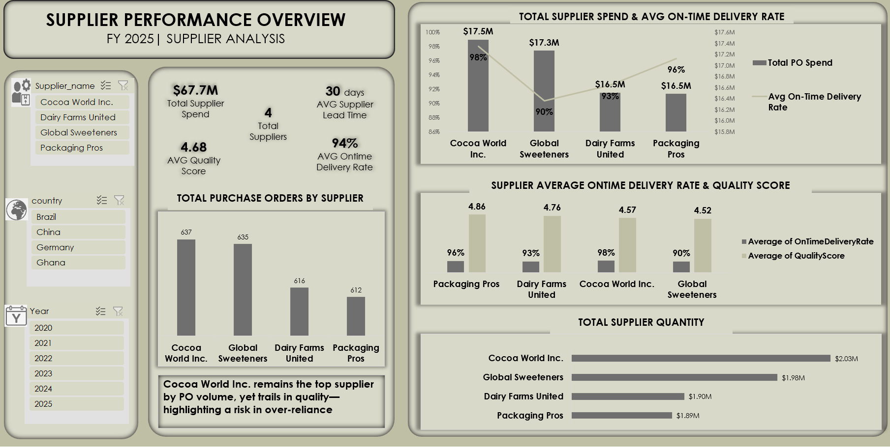

Slide 10
Dashboard 2 – PROCUREMENT PERFORMANCE OVERVIEW
PROBLEM STATEMENT: Limited visibility into monthly procurement trends and supplier-level spend has hindered cost optimization and strategic sourcing.
KEY KPIS:
Total Procurement Spend
Total PO Spend
Average Order Value
Monthly PO Trends
Supplier Spend Distribution
KEY INSIGHTS
Spend Concentration: Cocoa World Inc. and Global Sweeteners account for over 50% of procurement spend.
Stable Monthly Spend: Monthly PO spend remains consistent, peaking in October ($6.4M).
High PO Volumes: All suppliers exceed 26K POs annually, with Cocoa World Inc. slightly ahead.
Material Mix: Organic Cane Sugar (26%) and Ghana Cocoa Beans (25%) dominate procurement quantity.
RECOMMENDATIONS:
Supplier Mix Optimization: Reassess supplier contracts to reduce concentration risk and improve cost leverage.
Material Cost Analysis: Conduct cost-per-unit analysis for high-volume materials to identify savings opportunities.
Dynamic Order Sizing: Align PO volumes with seasonal demand and inventory levels to reduce excess.
Spend Forecasting: Use historical monthly trends to build predictive models for budget planning.

Slide 11
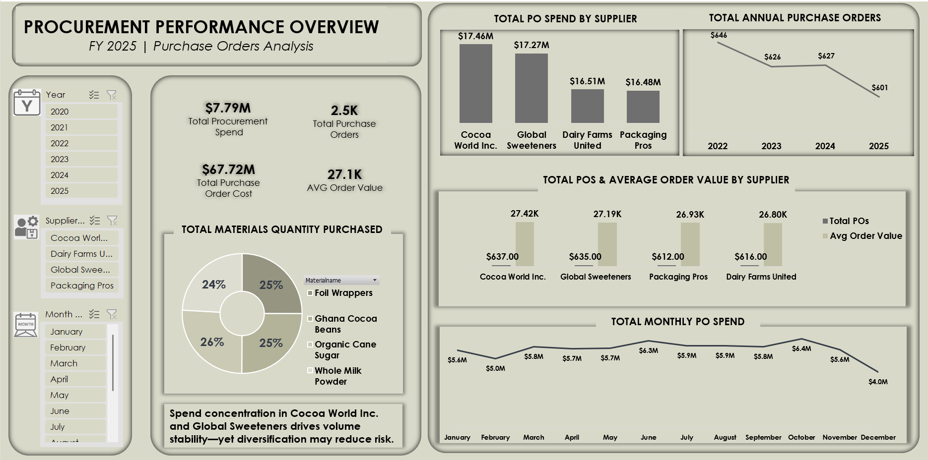

Slide 12
Dashboard 3 – INVENTORY & WAREHOUSE PERFORMANCE OVERVIEW
PROBLEM STATEMENT: Lack of visibility into inventory distribution and inbound trends has led to inefficient stock allocation and missed optimization opportunities.
KEY KPIS:
Stock Value
Total On-hand Inventory
Inbound Stock Value
Inventory Quantity by Warehouse
Inventory Value by Material
KEY INSIGHTS
Inventory Leader: North America Hub holds the largest inventory (26K), especially in Dairy and Packaging.
Stock Value Skew: Ghana Cocoa Beans account for 68% of total inventory value ($329.3K).
Inbound Peaks: July and November show highest inbound stock volumes (220K and 210K).
Balanced Distribution: Euro Hub maintains a more even product mix across categories.
RECOMMENDATIONS:
Inventory Rebalancing: Shift excess stock from North America Hub to underutilized hubs to reduce holding costs.
High-Value Material Control: Tighten tracking and reorder thresholds for Ghana Cocoa Beans to avoid overstocking.
Inbound Planning: Align inbound cycles with procurement and production schedules to minimize bottlenecks.
Warehouse KPIs: Introduce metrics like turnover rate and space utilization to optimize hub performance.

Slide 13
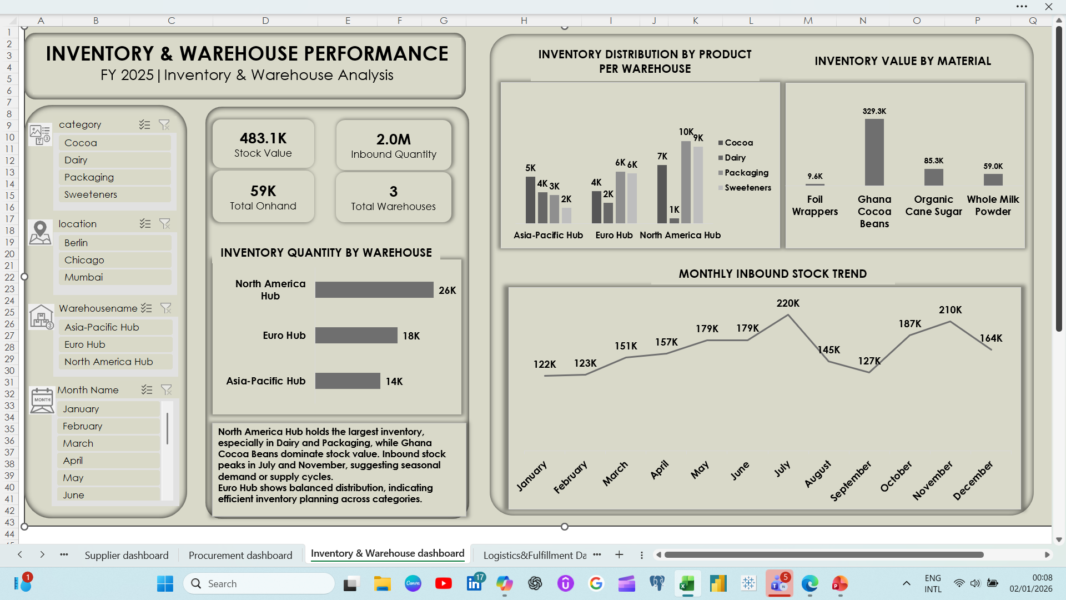

Slide 14
Dashboard 4 – LOGISTICS & FULFILLMENT PERFORMANCE
PROBLEM STATEMENT: Lack of visibility into shipment trends and carrier performance has limited proactive fulfillment planning and slowed delivery optimization.
KEY KPIS:
Total Shipments
Fulfillment Rate
Average Delivery Chain Time
Shipments by Carrier
Shipment Status Breakdown
KEY INSIGHTS
100% Fulfillment Rate: All shipments are fulfilled, with an impressive 1-day average delivery chain time.
Even Carrier Distribution: Shipments are evenly split across four carriers, with similar performance metrics.
Monthly Decline: Shipment volumes gradually decline from August (913) to December (654), hinting at seasonal shifts.
Status Balance: Shipment statuses are evenly distributed—Delayed, Delivered, In Transit, and Processing each ~25%.
RECOMMENDATIONS:
Seasonal Demand Mapping: Investigate causes of shipment decline and adjust procurement and inventory accordingly.
Carrier Performance Audits: Conduct deeper analysis into delay causes per carrier to improve SLA adherence.
Predictive Fulfillment: Use historical delivery data to forecast future logistics needs and optimize routing.
Status Automation: Implement real-time tracking and automated status updates to reduce manual processing.

Slide 15
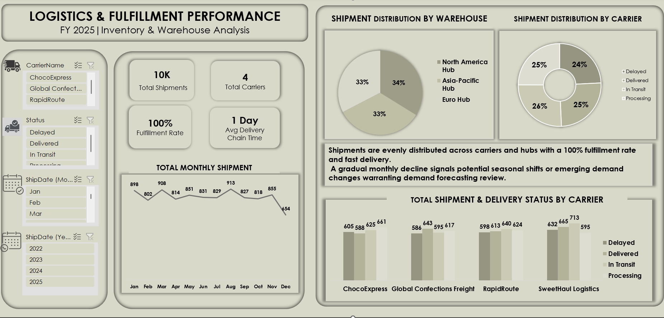

Slide 16
Data Model – End-to-End Procurement & Supply Chain
Overview: This data model underpins the entire analytics framework, integrating procurement, inventory, supplier performance, logistics, and fulfillment into a unified relational structure. It enables seamless reporting, cross-functional insights, and scalable dashboard development.
Key Components:
Procurement Layer:
  Purchase Orders and Purchase Order Lines track order-level and line-level details including supplier, material, quantity, and cost.
  Supplier and Supplier Performance enrich procurement data with country, delivery rate, quality score, and lead time.
Inventory & Warehouse Layer:
  Warehouse Inventory and Stock Movement monitor on-hand quantities, stock movements, and warehouse locations.
  Warehouse provides hub-level context for inventory distribution.

Slide 17
Logistics & Fulfillment Layer:
  Shipment Tracking and Fulfillment link carriers, shipment status, and delivery performance.
  Carrier supports carrier-level analysis and filtering.
Sales & Demand Layer:
  Sales Orders captures order volume and units sold across time dimensions.
Time Intelligence:
  Date Table enables dynamic filtering by year, month, and quarter across all fact tables.
Materials Reference:
  Raw Materials defines material categories, names, and unit costs for consistent reporting.
Relationships:
All fact tables are connected via shared keys (e.g., PO_ID, Supplier_ID, Material_ID, Warehouse_ID, Shipment_ID), enabling robust drill-through and cross-filtering across dashboards.
Strategic Value: This model supports end-to-end visibility across the supply chain, enabling performance tracking, cost control, and operational optimization.

Slide 18
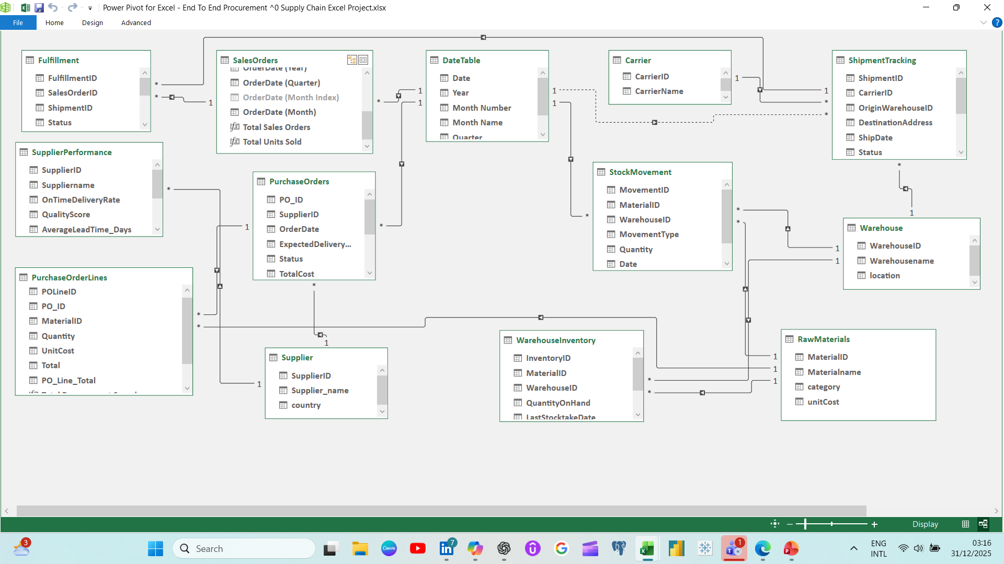

Slide 19
PROJECT OUTCOMES
This project transformed fragmented supply chain data into a clear, end‑to‑end performance story. By integrating supplier reliability, procurement spend, warehouse distribution, and logistics execution, the dashboards revealed how each stage influences the next and how operational decisions ripple across the entire value chain.
The analysis uncovered key strengths—such as high fulfillment rates, stable procurement activity, balanced warehouse distribution, and strong delivery performance—demonstrating a solid operational foundation. At the same time, it highlighted critical risks, including supplier quality inconsistencies, spend concentration, and seasonal fluctuations in both inbound stock and shipment volumes. These insights expose opportunities for cost optimization, supplier diversification, and improved demand planning.
As a result, the organization now has a powerful decision‑support tool that enhances transparency, strengthens planning accuracy, and enables proactive management of procurement, inventory, and logistics operations. This unified analytical framework supports data‑driven decision‑making, improves cross‑functional alignment, and drives strategic improvements across the entire supply chain ecosystem.

Slide 20
TOOLS & TECHNIQUES
Excel & Power Query: Data cleaning, transformation, advanced modeling, and analysis.
DAX (Advanced Excel): Complex calculations and building the data model.
Pivot Tables & KPI Calculations: Summarize and track key metrics.
Visualization Techniques: Conditional formatting, KPI cards, and charts to convey actionable insights effectively.
Open Interactive dashboard here

Slide 21
CONCLUSION
This project demonstrates my ability to deliver end-to-end supply chain intelligence by transforming raw operational data into clear, decision-ready insights. Through integrated analysis across procurement, inventory, logistics, and fulfillment, the project shows how data can be used to uncover inefficiencies, manage risk, and support informed business decisions.
The dashboards and insights are designed to serve cross-functional stakeholders, enabling leadership to evaluate performance, identify improvement opportunities, and align operational actions with strategic objectives.
The project reflects a strong understanding of how analytics supports real-world supply chain operations.
Overall, this work showcases my capability to build scalable, remote-ready analytical solutions that support data-driven decision-making in complex, multi-stakeholder environments.

